Slide 1

Purple Blossom
Presented by Austin Amash, Ian Yarwood, Christian Schulitz, and Logan Stanly

Slide 2
Table of contents
Game Overview
Game Lore
Gameplay Objectives
Game Features
Progression System
Technical Overview
Art Design
Music and sound
Game States
Interface
Level Design
Finial Thoughts and Reflection

Slide 3
Game Overview
Game Lore and Gameplay Objectives

Slide 4

Game Lore
The Purple Blossom universe is set in a dystopian future where two factions have established dominance on the local land.
Our main Antagonist group is the Green-Lotus Brotherhood who is fighting against the main protagonist the Purple Blossom for control over the local land and people.
As players progress through the game playing as the Purple Blossom, they will encounter a unique district boss at the end of each level.
As players defeat each district boss the Purple Blossom regains control over the land and retrieves a piece of his gear

Slide 5
Our Gameplay Objectives
Player Engagement and player retention:
Our approach to level design is a progressive approach to difficulty where beginning levels will first introduce the player to the core aspects of the game later providing challenging yet fun levels for players of all types to enjoy.
To encourage player retention, we implemented a progressive unlock system throughout the game. This system features an unlockable piece of equipment upon completing a level with the aim to motivate the player to finish the level.
Realistic World immersion:
To keep the player immersed in our game we focused on two main elements within level design and implementation
Realistic 3D elements that give the level a level of realness and immersion
Careful level design that keeps the levels feeling fun and realistic.

Slide 6
Game Features
The progression system and level design

Slide 7
Level Design
Level 1
An introductory level for the player that introduces the core elements of our game in a cohesive fun way, enabling the player to get a handle of the controls.
Level 2
A level that introduces the player to some of the core obstacles in the game as well as the introduction to equipment use.
Level 3
This level features an increased challenge to players offering an increased difficulty overall and the implementation of the wall running mechanic thanks to a scroll collected in the previous level.
Level 4
This level features the most challenge for all players, featuring a mix of all obstacle types and all abilities in the game.

Slide 8
Progression System
Level 1 No Items
No abilities can only move left and right at a constant rate.
Level 2 Gravity Boots
Enables the player to jump over obstacles.
Level 3 Wall running Scroll
Features an immersive blend of wall running and regular jumping
Level 4 Vortex Cloak
Combines all previous abilities including the new vortex cloak power enabling the player to phase through obstacles

Slide 9
Obstacles
Acid Pool
A pool of acid that instantly kills the player
Spinner
A spinning trap that has rotating arms that kill the player
Spike Trap
A trap that operates on a timer, sending spikes that will kill the player.
Bosses
Signals the end of the level the player will run past the boss to win.

Slide 10
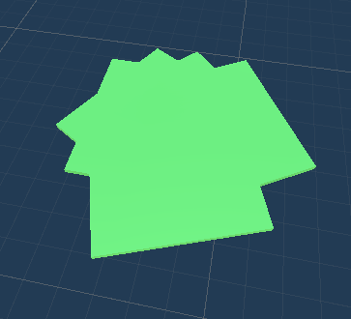
Acid Pool

Slide 11
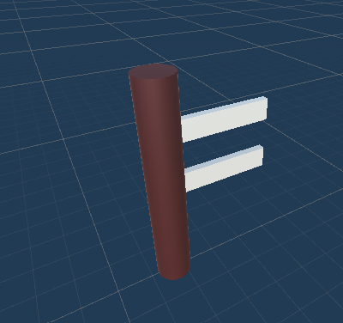
Spinner Trap

Slide 12
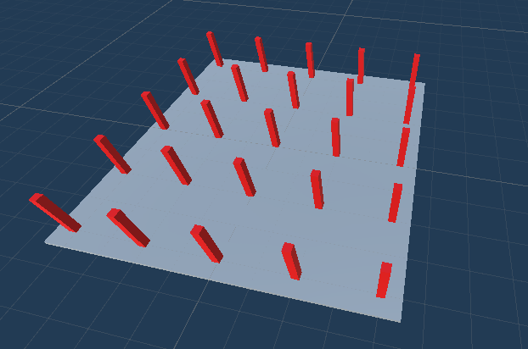
Spike Traps

Slide 13

Technical Overview
Art design, music, and game states

Slide 14
Art Design
Utilized Unity Assets Store.
Used a combination of multiple asset packs

Slide 15
Game Interface
Main Menu
A way for the player to navigate from level to level.
In game interface
Shows the game with no game elements present.

Slide 16
Music and Sounds
Leveraging the power of A.I we utilized Suno A.I to create unique musical scores for our menu and levels.
The A.I can produce any type of music, but we leaned into a more retro vapor wave feel that features a chiptune atheistic.

Slide 17
Game States and more
Running
The player runs at a constant rate.
Strafing
The player can move left and right through the level.
Jumping
The player can jump a medium distance.
Wall Running
The player can run on walls and jump off them.
Vortex Cloak
Allows the player to phase through objects in the level.

Slide 18
Final thoughts and group reflection
We each faced many challenges in creating this game:
Each of us would like to share a personal struggle with the project.
Features not implemented:
Laser Trap
If we had more time we would like to include:
Player sounds (IE. Jumping, using equipment, Ect.)
Polishing boss battles // interaction with bosses.
Endless Mode.
More refined Movement System
Smoother animations.

Slide 19
Works Cited

